Slide 1
BIG DATA
Big Data and Its Role in Business Analytics

Slide 2
NAME: OSHINJIRIN MODUPE ANUOLUWAPO
MATRIC NUMBER: 245712

Slide 3
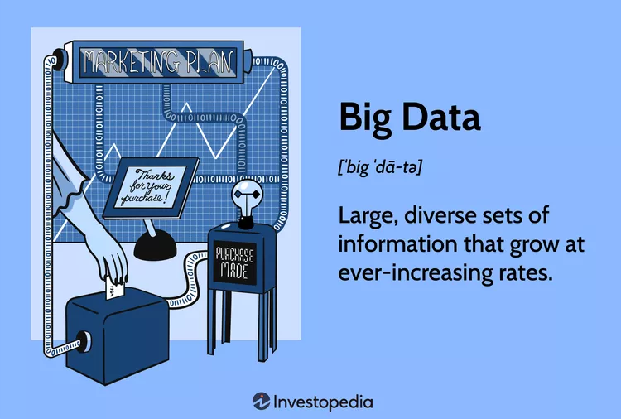
INTRODUCTION TO BIG DATA

Slide 4
What is Big Data?
Big Data refers to the vast amounts of structured, semi-structured, or unstructured data that are collected from various sources. It encompasses a wide range of data types, including:
Structured data: organized in a predefined format, such as tables or databases.
Semi-structured data: has some organization, but not rigid, such as XML or JSON files.
Unstructured data: lacks any organization or structure, such as text documents, images, or audio files.

Slide 5
Characteristics of Big Data
The four V's of Big Data:
1.Volume: massive amounts of data are collected, stored, and analyzed.
2.Velocity: data is generated at high speeds, requiring real-time processing and analysis.
3.Variety: data comes in various formats, from different sources, and has different structures.
4.Veracity: data may be inaccurate, inconsistent, or unreliable, requiring data validation and cleansing

Slide 6
Big Data Analytics and Applications
Some common Big Data use cases include:
Predictive analytics: forecasting future events, trends, or outcomes based on historical data.
Customer segmentation: identifying and categorizing customers based on behavior, demographics, or other characteristics.
Recommendation engines: providing product or content suggestions to users based on their preferences.
Risk management: detecting and mitigating potential risks, such as financial or operational threats.

Slide 7
Real-World Examples
Some notable examples of Big Data in action include:
Google's search algorithm: uses machine learning and natural language processing to provide personalized search results.
Netflix's recommendation engine: provides content suggestions based on user behavior and preferences.
Amazon's predictive analytics: uses machine learning to forecast demand and optimize supply chain operations

Slide 8
Big Data Tools and Technologies
Some popular tools and technologies used for Big Data processing include:
Hadoop: an open-source distributed computing framework for processing and storing large datasets.
Spark: an in-memory data processing engine for fast and efficient data processing.
NoSQL databases: such as MongoDB or Cassandra, designed to handle vast amounts of semi-structured or unstructured data.
Cloud-based services: such as AWS S3 or Azure Blob Storage, providing scalable and secure data storage.

Slide 9
Challenges and Opportunities
While Big Data offers numerous benefits, it also presents several challenges:
Data quality and security: ensuring data accuracy, consistency, and protection against unauthorized access.
Scalability and performance: meeting the demands of large amounts of data while maintaining processing speed and efficiency.
Interoperability and integration: integrating data from multiple sources while maintaining data consistency and accuracy.
Skills and talent: acquiring the necessary skills and expertise to effectively analyze and utilize Big Data.

Slide 10
In conclusion, Big Data has the potential to unlock valuable insights and drive business growth, but it also requires careful planning, execution, and management to ensure success.

